Slide 1

A BEGINNER’S GUIDE TO DATA ANALYSIS USING STATA

Slide 2
RECAP

Slide 3
RECAP
VARIABLE TYPES - STATISTICS:
Continuous variable: A variable with infinite number of values. Example, - Weight [23.2224], Length [34.235 cm]
Categorical variable: Variables than can be put into categories. Example, the category “Gender – [Male vs Female]”; “Units – [M&E vs HMIS vs Finance].
Discrete variable: A variable that can only take on a certain number of values. Example, “Number of cars – [5]”, “Number of children – [8]
Nominal variable: Another name for categorical variable but with no order. Example “Religion – [Christian, Muslim]”, “Gender – [Male vs Female].
Dichotomous variable: Another name for categorical variable with [only two] categories. Example: “Gender – [Male vs Female].
Ordinal variable: Similar to a categorical variable, but there is a clear order. For example, income levels of low, middle, and high could be considered ordinal. Risk perception – [Very likely, Likely, Not likely].
Dependent variable: The outcome of an experiment. For example – The outcome of this training.
Independent variable: A variable that is not affected by anything but affects the outcome. For example the effect of gender balance on the outcome of this training.

Slide 4
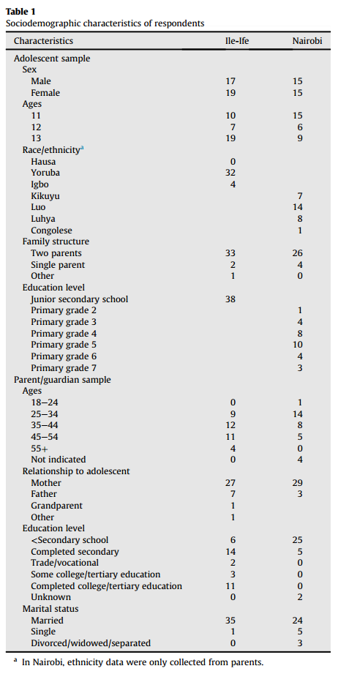
6
Ordinal
1
Nominal/Dichotomous
2
Continuous
7
Nominal
3
Nominal
8
Ordinal
4
Nominal
9
Nominal
5
Ordinal
SOURCE: Bello, B. M., Fatusi, A. O., Adepoju, O. E., Maina, B. W., Kabiru, C. W., Sommer, M., & Mmari, K. (2017). Adolescent and parental reactions to puberty in Nigeria and Kenya: A cross-cultural and intergenerational comparison. Journal of Adolescent Health, 61(4), S35-S41.

Slide 5
RECAP
VARIABLE TYPES - STATA:
Often denoted as black in STATA
Often denoted as red in STATA
Numbers
String
Integers
Float
Bytes (byt)
Integers (int)
Float (float)
Long (lng)
Double (double)
Long is denoted as blue in STATA

Slide 6
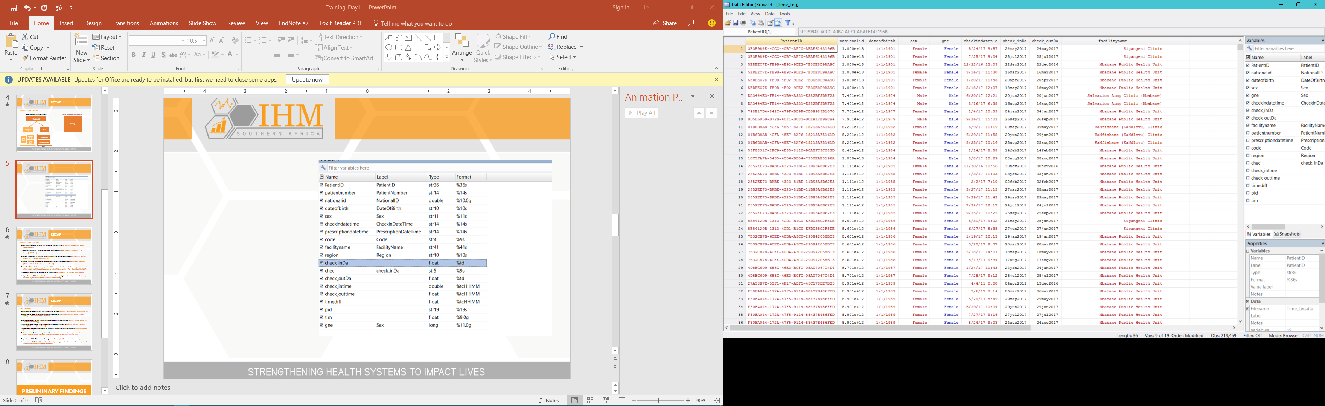
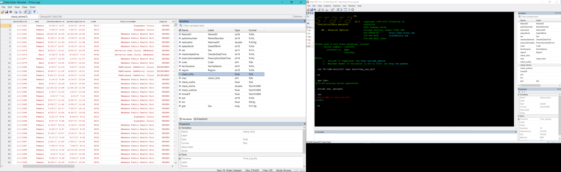
EXERCISE:
ANSWER:
WHAT VARIABLE TYPES ARE THESE?
SOURCE: Client Management Information System (CMIS), Swaziland.

Slide 7
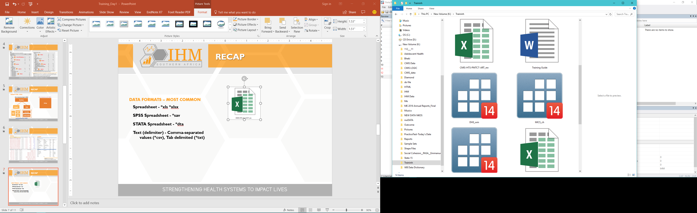
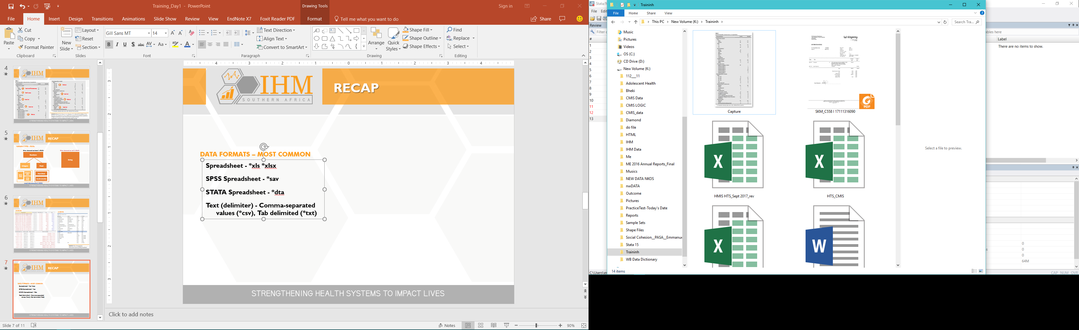
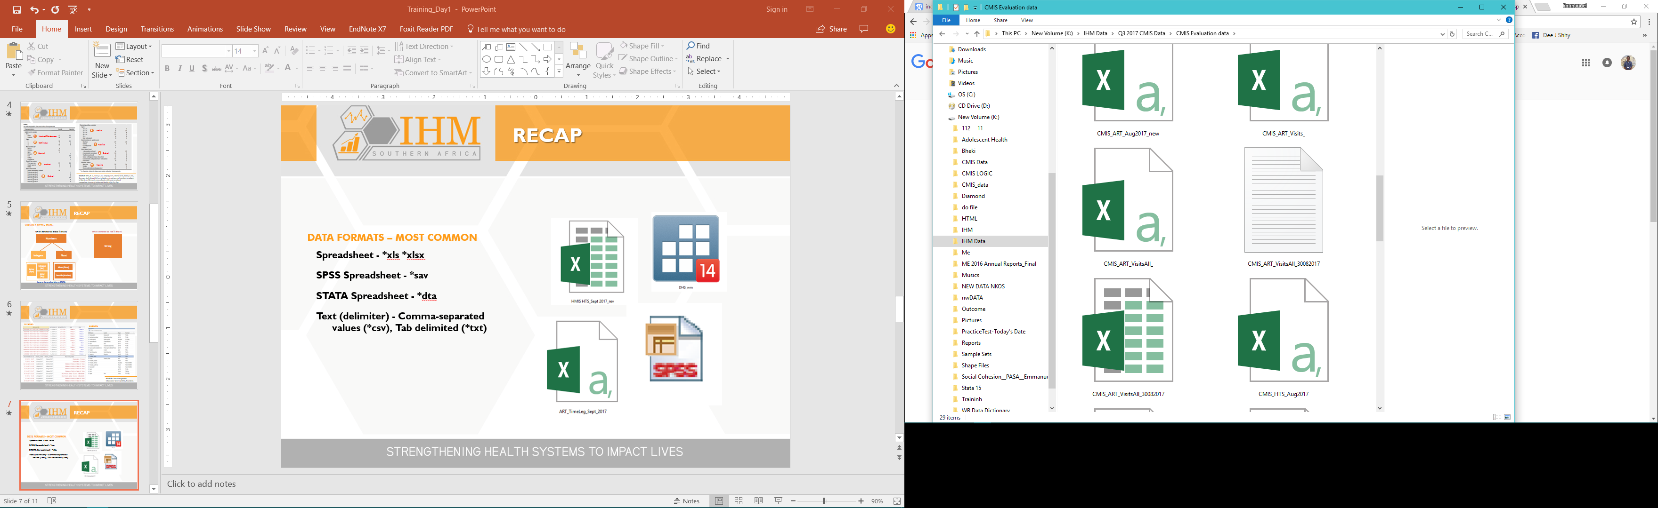
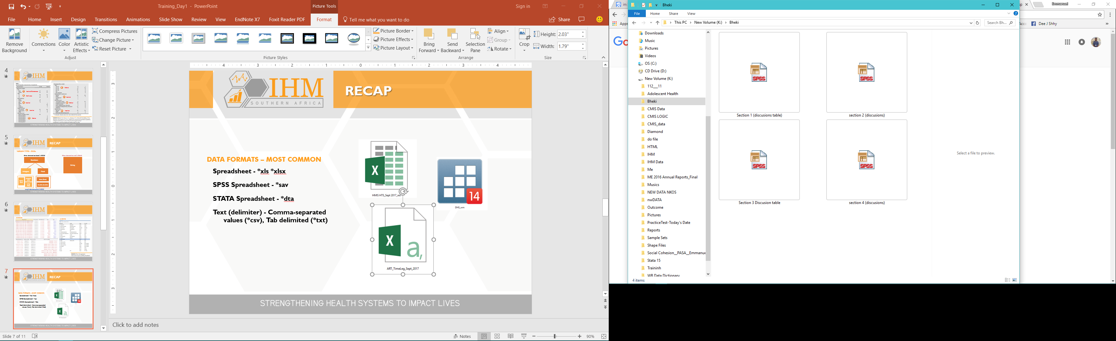
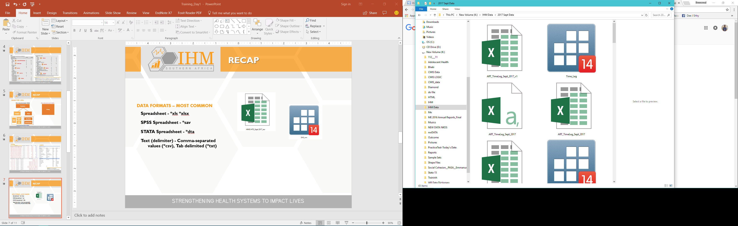
RECAP
DATA FORMATS – MOST COMMON
Spreadsheet - *xls *xlsx
SPSS Spreadsheet - *sav
STATA Spreadsheet - *dta
Text (delimiter) - Comma-separated values (*csv), Tab delimited (*txt)

Slide 8
AN INTRODUCTION TO STATA

Slide 9
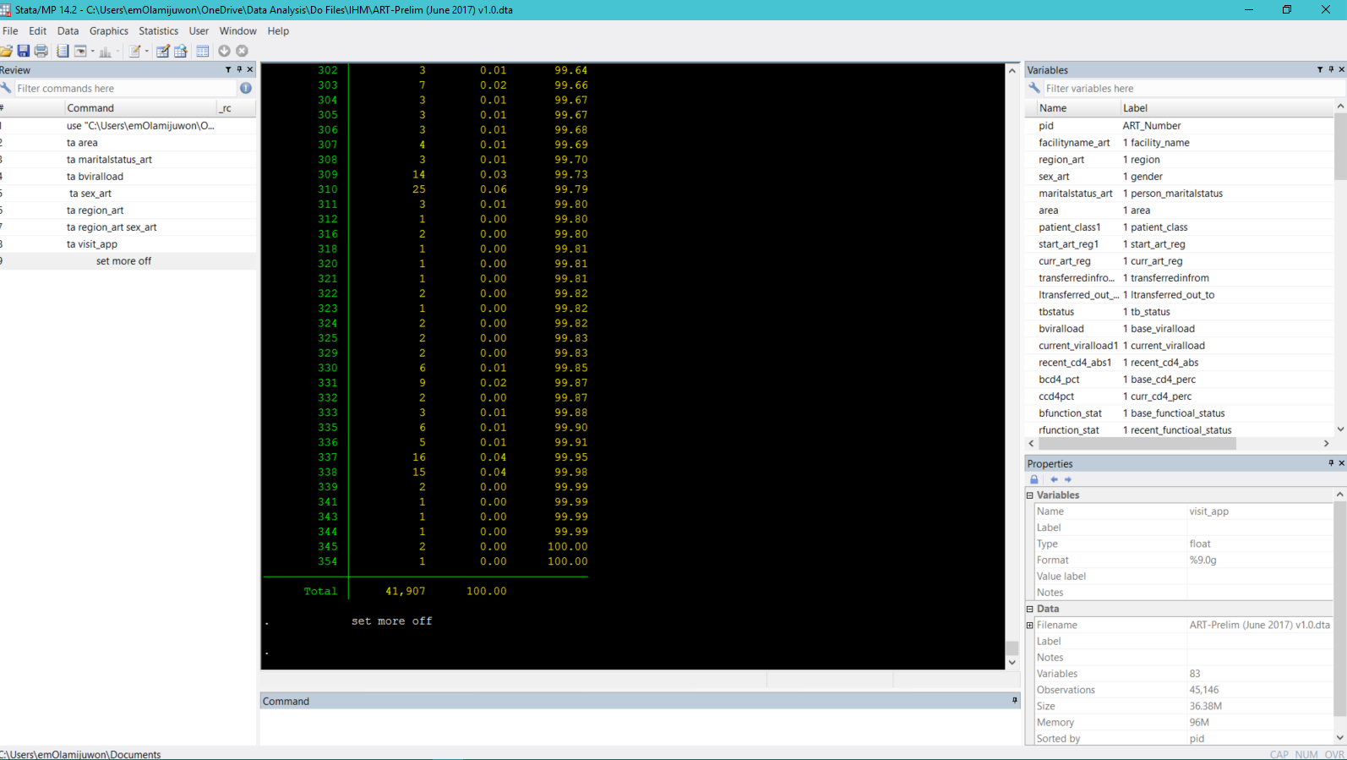
Introduction to STATA
VARIABLE TYPES - OTHERS:
Command Window
Review Window
Properties Window
Working directory
Command Window

Slide 10

Introduction to STATA
HI, I AM STATABOT
Want to TRY?
TO OPEN (USE) A DATASET: use "C:\Program Files\Stata14\auto.dta"
TO TABULATE “PRICE”:
tabulate price
TO SET MORE OFF:
set more off
TABULATE “PRICE” AGAIN: tabulate price
WHAT TYPE OF VARIABLE IS PRICE?
TELL ME TO TABULATE “FOREIGN”:
tabulate foreign
WHAT TYPE OF VARIABLE IS FOREIGN?
AND I SPEAK ENGLISH

Slide 11
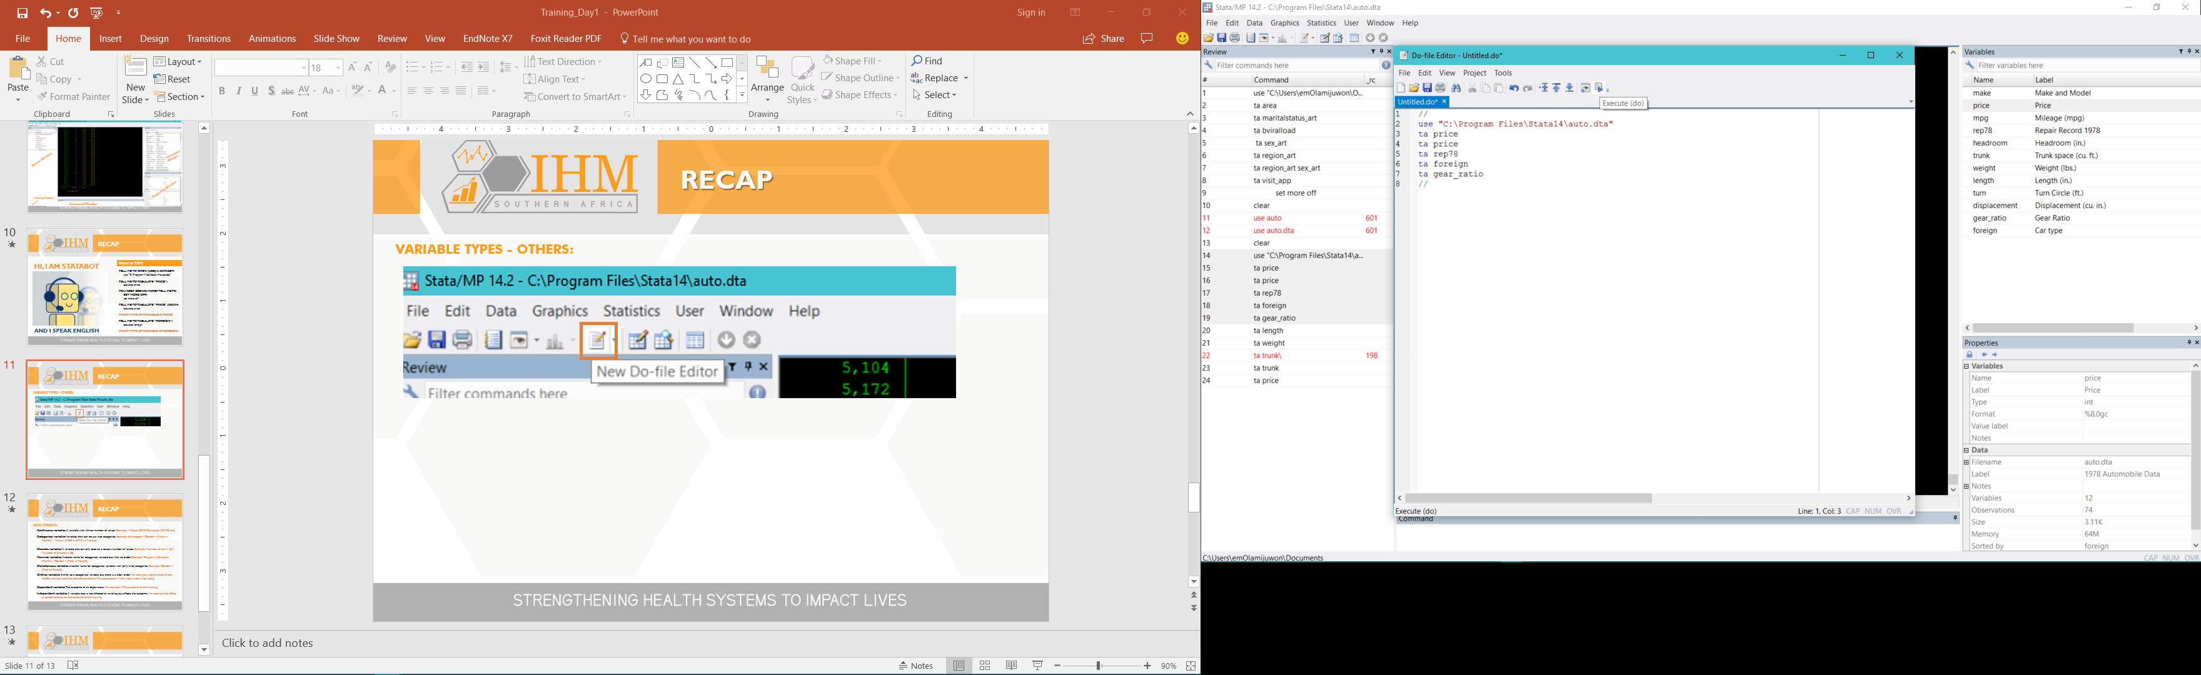

Introduction to STATA

Slide 12
READING DATA TO STATA

Slide 13
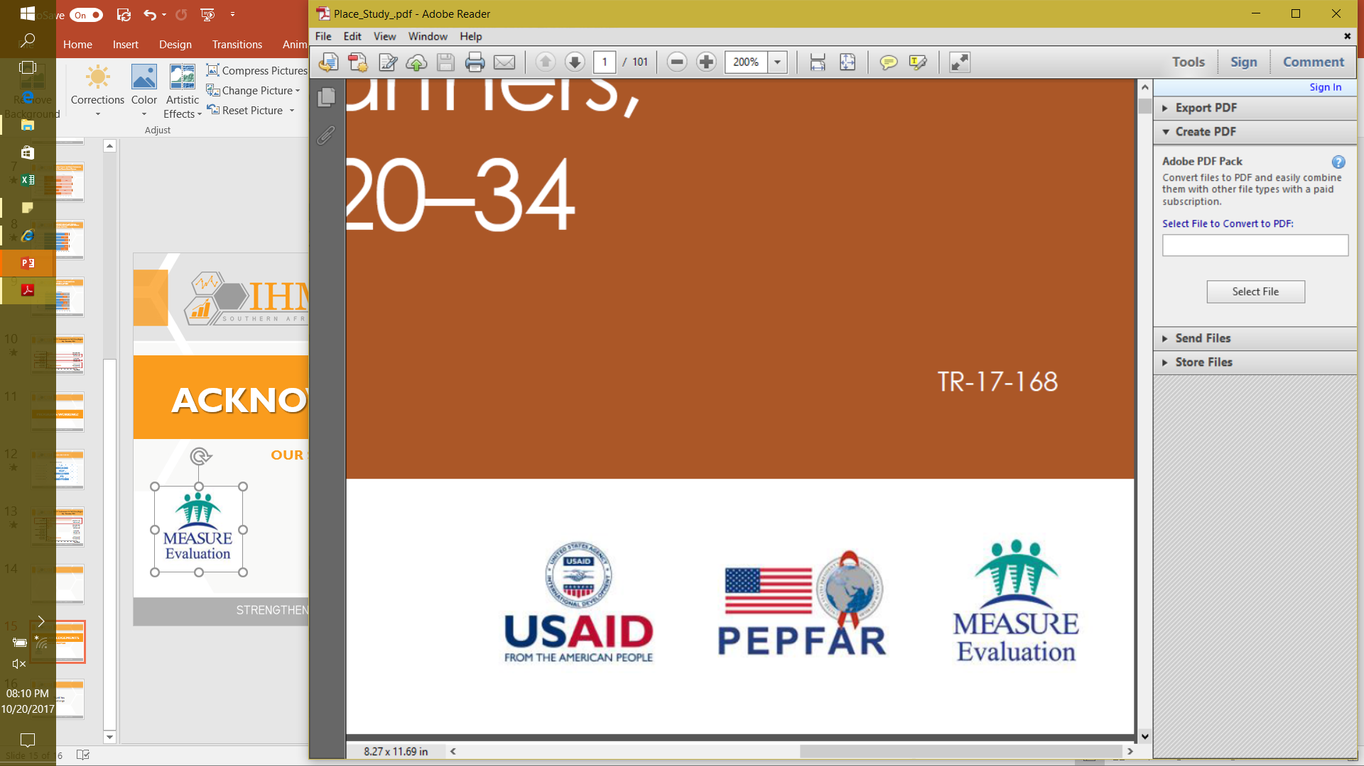

ACKNOWLEDGEMENTS
OUR SINCERE GRATITUDE

